Slide 1

Implementing Big Data in Bus Eireann
Jogil Jose (18230054)

Slide 2

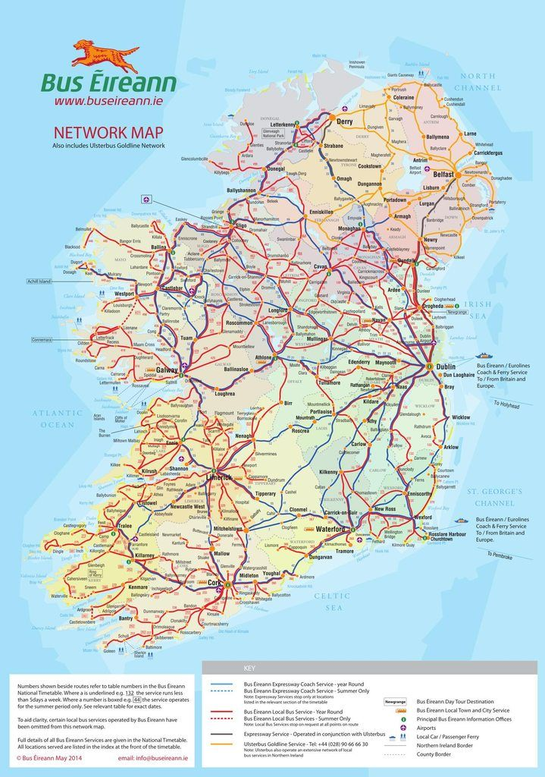
Overview – Bus Eireann
“The transportation industry can leverage Big Data analytics and data mining techniques to find solutions to transport problems such as traffic and transport network congestion across the globe”
Overall Summary:
Around 80.4 mn passenger journey in 2018
Over 115,000 children travel on 6800 dedicated school transport routes
More than 460 new school transport services approved by Dept. of Education and Skills in 2018.
Approx. 2,700 employees, with overall Turnover of €309mn €4.5mn

Slide 3














Leaders & Laggards in Big Data
I
Industry Leaders who have already implemented Big Data
Industry Laggards who are yet to implemented Big Data
a) IT Industry
a) Construction Companies
Planning to implement Big Data by 2020
b) Educational Services
Most of the Educational Services are yet to implement Big Data
b) Real Estate

Slide 4


Challenges & Opportunities in Big Data
1.Data policies
2.Technology and techniques
3.Organizational change and talent
4.Access to data
5.Industry structure
Businesses who are able to identify the right infrastructure for their big data project and follow best practices for implementation will see a significant competitive advantage.
Entrepreneurs have also capitalized on big data technology to create new products and services.

Slide 5

Value Proposition
Vehicle Efficiency
- Sensors attached to the vehicle
2. Staffing
- BGV of Staffs
3. Routes & Schedules
- Optimize the routes and schedules
4. Customer Experience
- Online polls, Sentimental Analysis
5. Business Forecasting
- Time-series prediction(ARIMA, MA, Holt-Winters)

Slide 6
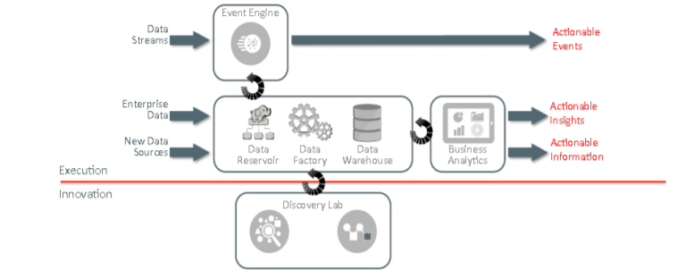
Big Data Architecture

Slide 7

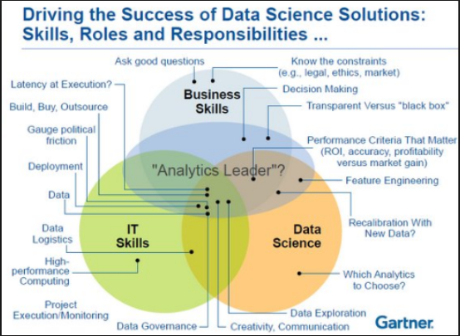
Big Data Skills

Slide 8
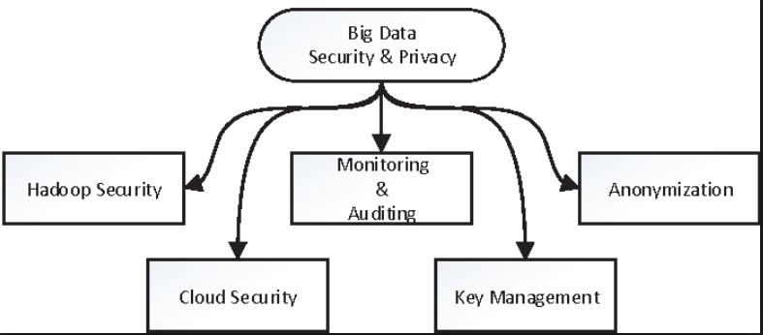
Big Data Governance & Security
1. Hadoop Security : Protecting Cluster’s access, data protection against unauthorized access.
2. Monitoring & Auditing: Reporting if an anomaly in usage patter is detected.
3. Annonymization: Encrypting personal information for safety measures.
4. Cloud Security: - Safety features like advanced configurations, automated encryption and access controls are incorporated in the cloud services.
5.Key Management: Administering or managing cryptographic keys for an encryption system

Slide 9

THANK YOU FOR TRAVELLING WITH US !!! ☺

